Slide 1
S08:
An Integrative Approach
to Long COVID
Ashley Drapeau PA-C, Dipl. Ac. M.Ac, MPAS
Medical Director
Director, Long COVID Program
GW Center for Integrative Medicine
Adjunct Associate Professor
George Washington University
Resiliency & Well-Being Center
Mikhail Kogan, MD
Chief Medical Officer
GW Center for Integrative Medicine
Associate Professor of Medicine, George Washington University
Founder and Member of the Board , AIM Health Institute, DC Based non profit delivering integrative services to underserved

Slide 2
DISCLOSURES
02

Slide 3

OBJECTIVES
Objective One
Describe the complexity and lack of resources for this novel illness
Objective Two
Identify symptoms and signs of Long COVID and distinguish it from other conditions
Objective Three
To explore the role of spirituality in coping with Long COVID, highlighting its impact on emotional resilience, meaning-making, and holistic recovery
Objective Four
Manage Long COVID with integrative techniques that are evidence based
03

Slide 4
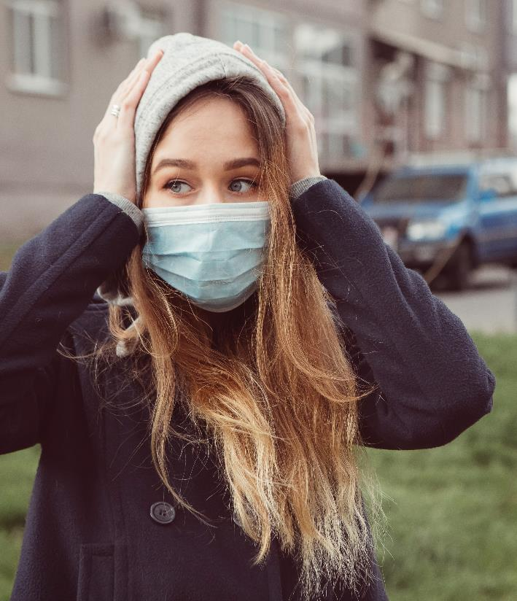
LONG COVID DEFINITIONS
Health and Human Services
WHO Definition
Long COVID, also known as
Post-COVID Conditions (PCC), is
an infection-associated chronic condition that can occur after
SARS-CoV-2 infection, the virus that causes COVID-19, and is present for at least 3 months as a continuous, relapsing and remitting, or progressive disease state that affects one or more organ systems
It is defined as the continuation
or development of new symptoms 3 months after the initial SARS-CoV-2 infection, with these symptoms lasting for at least 2 months with no other explanation.
04

Slide 5






ECONOMIC IMPACT
Mass Disabling Event
1 in 5 adults
Estimated 400 million people worldwide
Economic impact of about $1 trillion
Roughly 1% of global economy
Only 7-10% fully recovered at 2 years
05

Slide 6
Lopez-Leon, S., Wegman-Ostrosky, T., Perelman, C. et al. More than 50 long-term effects of COVID-19: a systematic review and meta-analysis. Sci Rep 11, 16144 (2021). https://doi.org/10.1038/s41598-021-95565-8
06

Slide 7


MECHANISMS
Persisting viral reservoirs
Immune dysregulation
Gut Dysbiosis
Reactivation of EBV/HSV
Microclotting
Endothelial dysfunction
Vagal nerve dysfunction
Autoimmunity
07

Slide 8
COMPLEXITY
Breeds scarcity
Very few Long COVID programs
Many losing funding and ending
Extended wait times
Lack of resources for novel whole body disease
Research years before yields actionable results
08

Slide 9

INTEGRATIVE MEDICINE
Multidisciplinary Clinics often employ about 6-10 different specialists
A study published in the Irish Journal of Medical Science found that only 8% of surveyed general practitioners (GPs) felt confident in diagnosing Long COVID
A JAMA Health Forum study (2022) found that post-COVID patients had significantly higher healthcare utilization, including specialist visits.
A 2021 Brookings Institution report estimated that many patients saw more than 4 specialists in their search for diagnosis and treatment
09

Slide 10
CASE STUDY #1
Mild acute symptoms, no hospitalization
Past medical history unremarkable except for multiple concussions
26 yo female
Unable to
work- lost job 01/2022
Contracted COVID 11/2021
Main post COVID symptoms: post COVID fatigue, palpitations, cognitive dysfunction, anxiety, nausea, dizziness, and weight loss, sleep disturbance
Bending over, standing, sensory stimulation make it worse
10

Slide 11
CASE STUDY #1
Supplements:
nattokinase, wright salt, mitocore protein powder, nox synergy powder, glutathione, fish oil, PC, green coffee extract
Modalities:
acupuncture 1-2x per week, MBSR, speech therapy, physical therapy
NeuroQuant MRI showed 14% hippocampal volume
All other labs normal except for positive thyroid antibodies
Nutreval showed highest needs: oxidative stress and inflammation
Given IV high dose vitamin C, myers, mag, B12
Medication:
low dose naltrexone
Outcome:
working full time in person, exercises, continues acupuncture every other week
11

Slide 12
CASE STUDY #2
Low oxygen sat- put on supplemental oxygen and given Paxlovid in acute illness
Given 45 days for management to return to duty
32 yo female
Peace Corp
“feels like my brain is
a lagging computer”
Medically evacuated to CIM from Ecuador, altitude 9k above sea level
Long COVID duration 8 months
Shortness of breath on exertion, post exertional malaise, brain fog
Full work up in country, i.e. Echo, chest xray, EKG, labs, etc
12

Slide 13
CASE STUDY #2
Outcome 1 month later: About 80% improvement, SOB resolved, able to hike 1.5 miles per day, brain fog improved, Peace Corp discharged patient led to huge regression in symptoms
Low dose naltrexone- titration to 4.5mg
Long COVID Groups 1x per week
Referral to speech
Acupuncture 2x per week
Heartmath device and training by breath coach
Supplements:
L-tyrosine, lions mane, Bryonia Albia, BCQ, DHA, Mitocore, vitamin D3/K2, CBDA
13

Slide 14

COLLABORATIVE PARADIGM
Work with rehabilitation services I.e speech, PT, OT
Frequency of visits
Grows agency over symptoms/disability
Expands knowledge about movement/effective pacing
Complementary modalities: Acupuncture/craniosacral/SE/massage
Breath work
Whole body care
14

Slide 15








MANAGEMENT STRATEGIES
Optimize lifestyle factors
Pharmacological options
Validate and listen
Establish patient goals
Hands on modalities
Rehabilitation
Supplementation
Refer appropriately
15

Slide 16
INTEGRATIVE MODALITIES
Need for multi-disciplinary approach
LDN
Mitochondrial support
(cytokines injure mitochondria)
Gingko, ginseng, Chinese herbs
Flavonoids:
quercetin and Luteolin protect against neuroinflammation/oxidative stress
Treat any toxicity
Caffeine
Green tea
Vitamins
Minerals
Lipids
Metabolites
Cofactors
Transporters
Antioxidants
Herbs
Vitamins C, D and E, thiamine, riboflavin
Magnesium, calcium, phosphate
Membrane phospholipids, unsaturated fatty acids
Creatine, pyruvate
CoQ₁₀, α-lipoic acid, NADH, nicotinic acid
l-Carnitine, membrane phospholipids
CoQ₁₀, α-lipoic acid, NADH, glutathione
Curcumin, schisandrin
Enzyme inhibitors
α-Lipoic acid, dichloroacetate
16

Slide 17
THE SPITIRUAL DIMENSION OF LONG COVID
The Spiritual Dimension of Long COVID: Finding Meaning and Resilience
The Lancet Psychiatry reported that individuals with long COVID experienced a 10% increase in suicidal ideation compared to those without the condition
individuals who had COVID-19 were 46% more likely to experience suicidal thoughts during the post-acute phase than those who did not contract the virus
Positive correlation between social support and resilience in long COVID
Sher L. Long COVID and the risk of suicide. Gen Hosp Psychiatry. 2023 Jan-Feb;80:66-67. doi: 10.1016/j.genhosppsych.2022.12.001. Epub 2022 Dec 5. PMID: 36494289; PMCID: PMC9721155.
17

Slide 18

PSYCHEDELICS
Hosted an 8 person long COVID retreat
weekend using IM ketamine
Participants knew each other from groups
Diversity in previous use history
Matched into peers
On follow up, all saw improvements in
perspectives related to their disease
Improvements in anxiety and depression
Several patients had pain relief, one patient had resolution of pain for 3 months
18

Slide 19

GW CIM LONG COVID GROUPS
Experiential practice
Voluntary
Education on integrative topics
Rolling Admission
One low monthly fee
GW CIM
Long COVID Groups
Members from all parts of US
3 weekly groups, virtual
Peer Support
No obligation cancel anytime
Whole body approach
19

Slide 20
MEDICAL CANNABIS
CBMPs
Pain
Anxiety
Depression
Fatigue
Sleep
Headache/Migraine
Cognitive Dysfunction
Long COVID
Epilepsy
Multiple Sclerosis
Cancer-Related Nausea
Inflammatory Bowel
Disorders
Hair Loss
Palpitations
Tachycardia
20

Slide 21

ACUPUNCTURE
Comprehensive analysis evaluated acupuncture's impact on symptoms common
in long COVID, such as fatigue, depression, cognitive impairment, headache, and insomnia
Concluded that acupuncture significantly improved these conditions compared to standard treatments or sham procedures
Case report concluded that acupuncture alleviated chest pain and heart palpitations
Ongoing study looking at fatigue related to long COVID and acupuncture
21

Slide 22

LDN AND LONG COVID
2022, interventional study Long COVID showed improved in symptoms 6/7 parameters measured
Naltrexone competitive opioid receptor antagonist
Blocks the effects of opioids
Works at mu, delta, and kappa receptors
Increases endorphins and enkephalins= pain relief, reduce autoimmune dysfunction
Enkephalin is opioid growth factor
Acts as growth factor in neural and non-neural tissue
Plays a role in cell proliferation, helps in angiogenesis
22

Slide 23

LDN
Reversible, can use opioids with LDN if needed or emergency
Not addicting
Disease modifying, not symptom relieving
Uses: chronic pain, fatigue, autoimmune dysfunction, Mast cell activation, brain fog
Acts on Glial cells (immune cells of the brain)
Glial cells get activated-produce neuro-inflammatory chemicals (toll like receptors)
Neurons get inflamed
23

Slide 24
MAST CELL ACTIVATION SYNDROME
Disease first reported in 2007, prevalence of 17% population
Often goes undiagnosed
Dysfunction in behavior of mast cells following COVID leads to release of cytokines
Inappropriate activation of mast cells = histamine, heparin, tryptase, chemokines, prostaglandins
Lung biopsies of COVID patients, large numbers of mast cells
Histamine, Plasma >8
Tryptase
Serum Chromogranin-A
Random and 24 hour urine- N-methyl histamine, histamine, prostaglandin D2, leukotriene
Heparin- difficult to detect, lab ranges need to go down to 0
GI tract is the best- biopsy staining for CD117 >20 mast cells positive for MCAS
24

Slide 25
MCAS AND LONG COVID
Does mast cell activation baseline/pre-existing explain hyper-inflammatory responses in acute COVID and long COVID?
2021 study in International Journal of Infectious Diseases
25

Slide 26
SYMPTOMS
26

Slide 27

TREATMENT

Slide 28
TREATMENT
Block H1 and H2 by antihistamines, i.e. zyrtec, pepcid
Mast cell stabilizers- cromolyn
Other mediator inhibitors- LDN, NSAID COX2 (celebrex), corticosteroids, benzos
Singulair
Reduce inflammation and methylation defects
Low histamine diets
Quercetin, Luteolin, Vitamin C, D, NAC, Turmeric, alpha lipoic acid, B12/folate if needed, natural D hist, Dao enzyme
Lactobacillus rhamnosus- certain probiotic strains decrease histamines
Limbic retraining
28

Slide 29
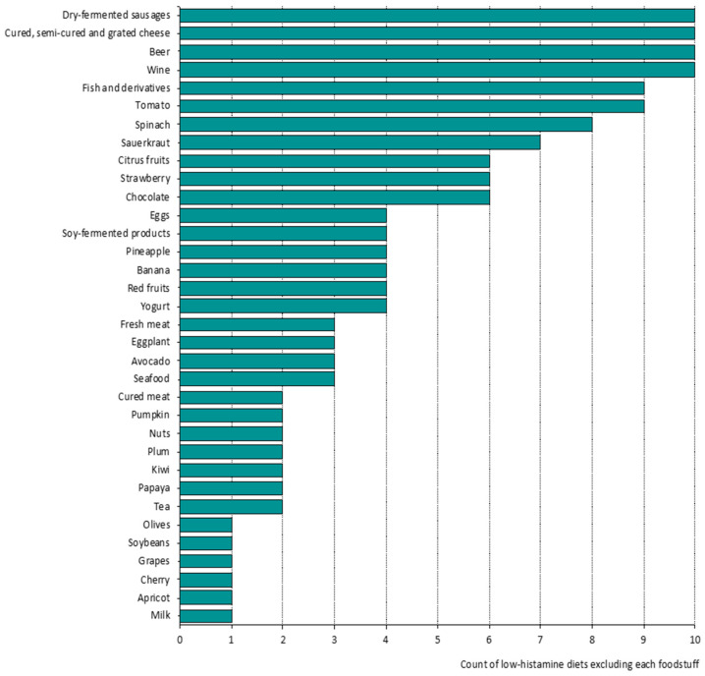
HISTAMINE FOOD
29

Slide 30
DYSAUTONOMIA
Recent study shows that COVID-19 infects the vagus nerve causing inflammation
Vagus nerve impacts most systems of the body
Symptoms: chronic fatigue, headaches, myalgias, nausea, brain fog, exercise intolerance, shortness of breath, weakness, lightheadedness, blurriness of vision, shakiness, anxiety
POTS, Orthostatic hypotension
Decreased blood flow to brain
Can cause syncope
30

Slide 31
AUTONOMIC DISORDERS AFTER COVID
20 patient case study
70% female
15 POTS, 3 neurocardiogenic syncope, 2 orthostatic hypotension
4 elevated autoimmune or inflammatory markers
6-8 months after infection, 85% residual autonomic symptoms
60% unable to return to work
Blitshteyn S, Whitelaw S. Postural orthostatic tachycardia syndrome (POTS) and other autonomic disorders after COVID-19 infection: a case series of 20 patients. Immunol Res. 2021 Apr;69(2):205-211. doi: 10.1007/s12026-021-09185-5. Epub 2021 Mar 30. Erratum in: Immunol Res. 2021 Apr 13;: PMID: 33786700; PMCID: PMC8009458.
31

Slide 32

DYSAUTONOMIA TREATMENT
Treatments: increase salt and fluid (2-3g salt and 2L of fluid), salt retains fluids in blood vessels and maintain a healthy blood pressure
Compression study: waist high most important
Volume expansion is important but does not prevent flares/reverse symptoms in significant way
Medications: Increase blood volume (Florinef), improve vasoconstriction (stimulants, midodrine), Interfere with release of nor/epi (beta blockers)
IVIG 2g/kg every 4 weeks, can take 6-7 months to work, indef
Other meds: plaquenil, methotrexate (good for jt/muscle pain), rituximab (if IVIG fails)
Integrative approach: lifestyle factors, testing for micronutrient deficiencies, food sensitivities, gut health
32

Slide 33
HELPFUL RESOURCES
Long COVID: major findings, mechanisms and recommendations
Published: 13 January 2023
Hannah E. Davis, Lisa McCorkell, Julia Moore Vogel & Eric J. Topol
Nature Reviews Microbiology volume21, pgs133–146 (2023)
https://longcovidalliance.org
https://www.longhauler-advocacy.org
https://patientresearchcovid19.com
http://www.dysautonomiainternational.org
https://supertmastcell.org
https://www.aapmr.org/members-publications/covid-19/multidisciplinary-quality-improvement-initiative
33

Slide 34
HELPFUL REFERENCES
Abebe, W. (2019, January 8). Review of herbal medications with the potential to cause bleeding: Dental implications, and risk prediction and prevention avenues.
The EPMA journal. Retrieved September 6, 2022, from https://www.ncbi.nlm.nih.gov/pmc/articles/PMC6459456/
Alzaabi, M. M., Hamdy, R., Ashmawy, N. S., Hamoda, A. M., Alkhayat, F., Khademi, N. N., Al Joud, S. M. A., El-Keblawy, A. A., & Soliman, S. S. M. (2022). Flavonoids are promising safe therapy against COVID-19. Phytochemistry reviews : proceedings of the Phytochemical Society of Europe. Retrieved September 6, 2022, from https://www.ncbi.nlm.nih.gov/pmc/articles/PMC8139868/
Centers for Disease Control and Prevention. (2022, June 22). Nearly one in five American adults who have had COVID-19 still have “long covid.” Centers for Disease Control and Prevention. https://www.cdc.gov/nchs/pressroom/nchs_press_releases/2022/20220622.htm
Davis, H.E., McCorkell, L., Vogel, J.M. et al. Long COVID: major findings, mechanisms and recommendations. Nat Rev Microbiol 21, 133–146 (2023). https://doi.org/10.1038/s41579-022-00846-2
Chopra, P. Low dose naltrexone use in dysautonomia, chronic pain, and MCAS. https://vimeo.com/showcase/9427510/video/737568546. Retrieved: October 12, 2022.
Jang, S., Kelley, K. W., & Johnson, R. W. (2008, May 27). Luteolin reduces IL-6 production in microglia by inhibiting JNK phosphorylation and activation of AP-1. Proceedings of the National Academy of Sciences of the United States of America. Retrieved September 6, 2022, from https://www.ncbi.nlm.nih.gov/pmc/articles/PMC2396685/
National Academies of Sciences, Engineering, and Medicine; Health and Medicine Division; Board on Health Care Services; Forstag EH, Denning LA, editors. Long COVID: Examining Long-Term Health Effects of COVID-19 and Implications for the Social Security Administration: Proceedings of a Workshop. Washington (DC): National Academies Press (US); 2022 Jun 30. 2, Overview of Long COVID and Disability. Available from: https://www.ncbi.nlm.nih.gov/books/NBK585192/
O’Kelly, B., Vidal, L., McHugh, T., Woo, J., Avramovic, G., & Lambert, J. S. (2022). Safety and efficacy of low dose naltrexone in a long covid cohort; an interventional pre-post study. Brain, Behavior, & Immunity. Health, 24, 100485–100485. https://doi.org/10.1016/j.bbih.2022.100485
Rowe, P. Chronic Fatigue Clinic. Johns Hopkins. https://www.dysautonomiainternational.org/pdf/RoweOIsummary.pdf
Suran M. Long COVID Linked With Unemployment in New Analysis. JAMA. 2023;329(9):701–702. doi:10.1001/jama.2023.0157
W;, A. (n.d.). Hypercoagulability in covid-19: A review of the potential mechanisms underlying clotting disorders. SAGE open medicine. Retrieved September 6, 2022, from https://pubmed.ncbi.nlm.nih.gov/33815798/
34

Slide 35
Questions?
Contact Us Now!
adrapeau1@gwu.edu
adrapeau@gwcim.com
mkogan@gwcim.com
mkogan@mfa.gwu.edu
35

